Slide 1
Messaging other sprites

Slide 2
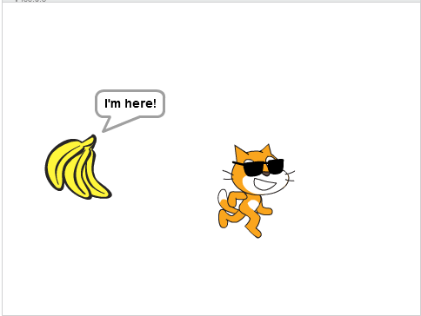
Action Coordination
Our Sprites do not have hands or legs, but any normal robots will have more than one body part. The drinking machine is also a kind of robot. It has a display panel, a slot to collect money, and the drink dispenser. The several parts require some coordination. They are not turned on one by one. In fact, they are all "on" since we turn on the machine with a single on-off switch. They wait for a certain entry point to perform their action.
A dancing robot will very well have used the timing technique we used in Module 2, to raise the arms, and stretch the legs now and then. Physical sensors are more like the technique we used in Module 3. The money collecting slot will stay alert—waiting, until a coin passes through.
Sometimes, we just cannot afford to rely on physical contact. We need a way to wake a remote friend for some actions. Sometimes, not just one friend. We want to broadcast an alert and make everyone react. This is where the message mechanism comes in. It's different from the wait-until block by that, it always starts its own group of blocks. The wait-until block would occupy the Sprite and jam its action, unless you have parallel actions. On one hand, it is a great way to coordinate multiple Sprites. But now, you need to keep an eye for conflicting actions more carefully than ever.

Slide 3
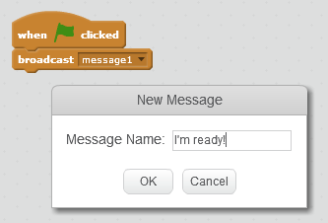

Messages
The message mechanism is easy to use. Go to the Events block pane, and drag out a broadcast-message1 block for the Sprite who would give the signal. "message1" is a sample message that you can use. For your own convenience, you should design message names to be more comprehensible, like "go", "turn", "enemy ahead".
For Sprites that should react on the message, you should drag out a when-I-receive-message1 block, from the Events block pane again, for each of them. Of course you should choose the appropriate message name from the drop down menu. It has the round cap like the when-green-flag-clicked block, which means it is an entry point to a subprogram, and you should add blocks under it to perform actions.
One highly potential source for conflicts of action is repetitive broadcasting of messages. Maybe the situation to broadcast the message is too easily met. Perhaps the actions following the message is too long to finish before the next message arrives. Similar to the edge touching example, you should make the Sprite leave the message broadcasting situation when enough messages have been sent, and usually you only need to send it once.

Slide 4
Choosing the Sprite to Send Message
At times, it is easy to choose which Sprite to send the message. That will be the Sprite that meets a situation and needs to notify other Sprites. However, there will also be times that two Sprites bump into each other and need to notify a third Sprite. Then which of the two Sprites should send the message? Apparently you cannot make both do, as the third Sprite will receive too many messages. Well, you don't need to worry too much. Probably you just need either one of the Sprites to send it good enough. If one of the Sprites will move after the meeting, move away from the message sending situation, it will be good to choose this Sprite, to avoid repetitive broadcasting of messages.

Slide 5
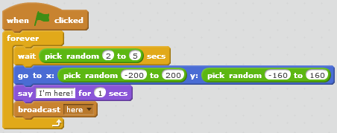
Steps of the example
In this example, a comb of bananas will pop up at different places after staying there for a few seconds. Sprite cat will trace its whereabouts, attempting to eat it. But the Sprite cat is not seeing well... It will only turn to the bananas after the bananas call. You can see a sample screenshot of the running program in the Review and Preview reading.
Bananas
Add the Bananas Sprite.
Gather the below blocks for the Bananas Sprite.

Slide 6
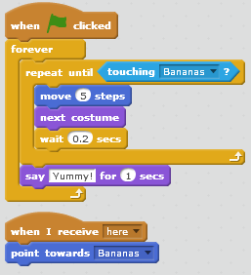
Steps of the example
Sprite1
The Sprite is given a pair of ink dark glasses for a funny look.
Set the rotation style to left-right.
Gather the below blocks.

